Slide 1




Total Eclipse of the Excel Chart :
A reflection on 12 years of teaching modelling and data science in the NHS
Dr Daniel Chalk
(Senior Research Fellow and HSMA Programme Director,
NIHR Applied Research Collaboration for the South West Peninsula
(PenARC))

Slide 2




Don’t Stop Believin’
Early Vision :
Every NHS organisation would have in-house skills to undertake modelling to support their decision making.
We would do this by recruiting “Associates” who would work with us, we would teach and support, they would undertake and champion.
Clear need early on to develop skills in NHS to do our kind of work (see pen on piece of string on map)
Small team (four of us at the time)
Were using primarily proprietary software (and expensive!)
So how?

Slide 3

Bill and Ted’s EXCELlent Adventure
TAKE 1
Excel-based Discrete Event Simulation Training (2014 - 2016)
Collaboration with ABCi modelling team in Cardiff
Introduced principles and potential of Operational Research for healthcare
Taught a “simple” DES in… Excel 🤮(theory : get people using what they know)
Then how to do it in 30 seconds in Simul8…

Slide 4


Bill and Ted’s EXCELlent Adventure
Lots of interest in modelling and Operational Research
Huge opportunities - existing approaches often well behind the curve
Generated interest, but (to our knowledge) no impact
Don’t build DES models in Excel. Just, don’t
Felt like more of a sales pitch for £3k Simul8 licenses
Encouraged bad practices
Hugely time consuming
There must be a better way…

Slide 5
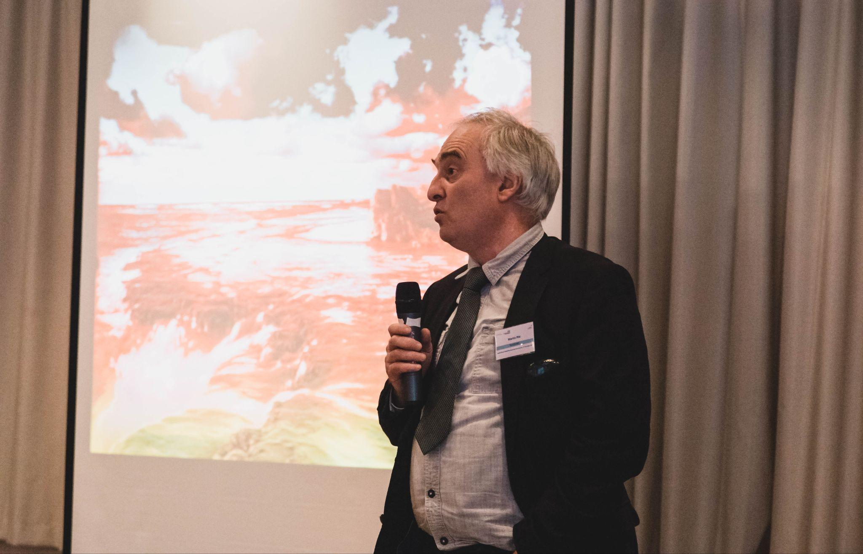
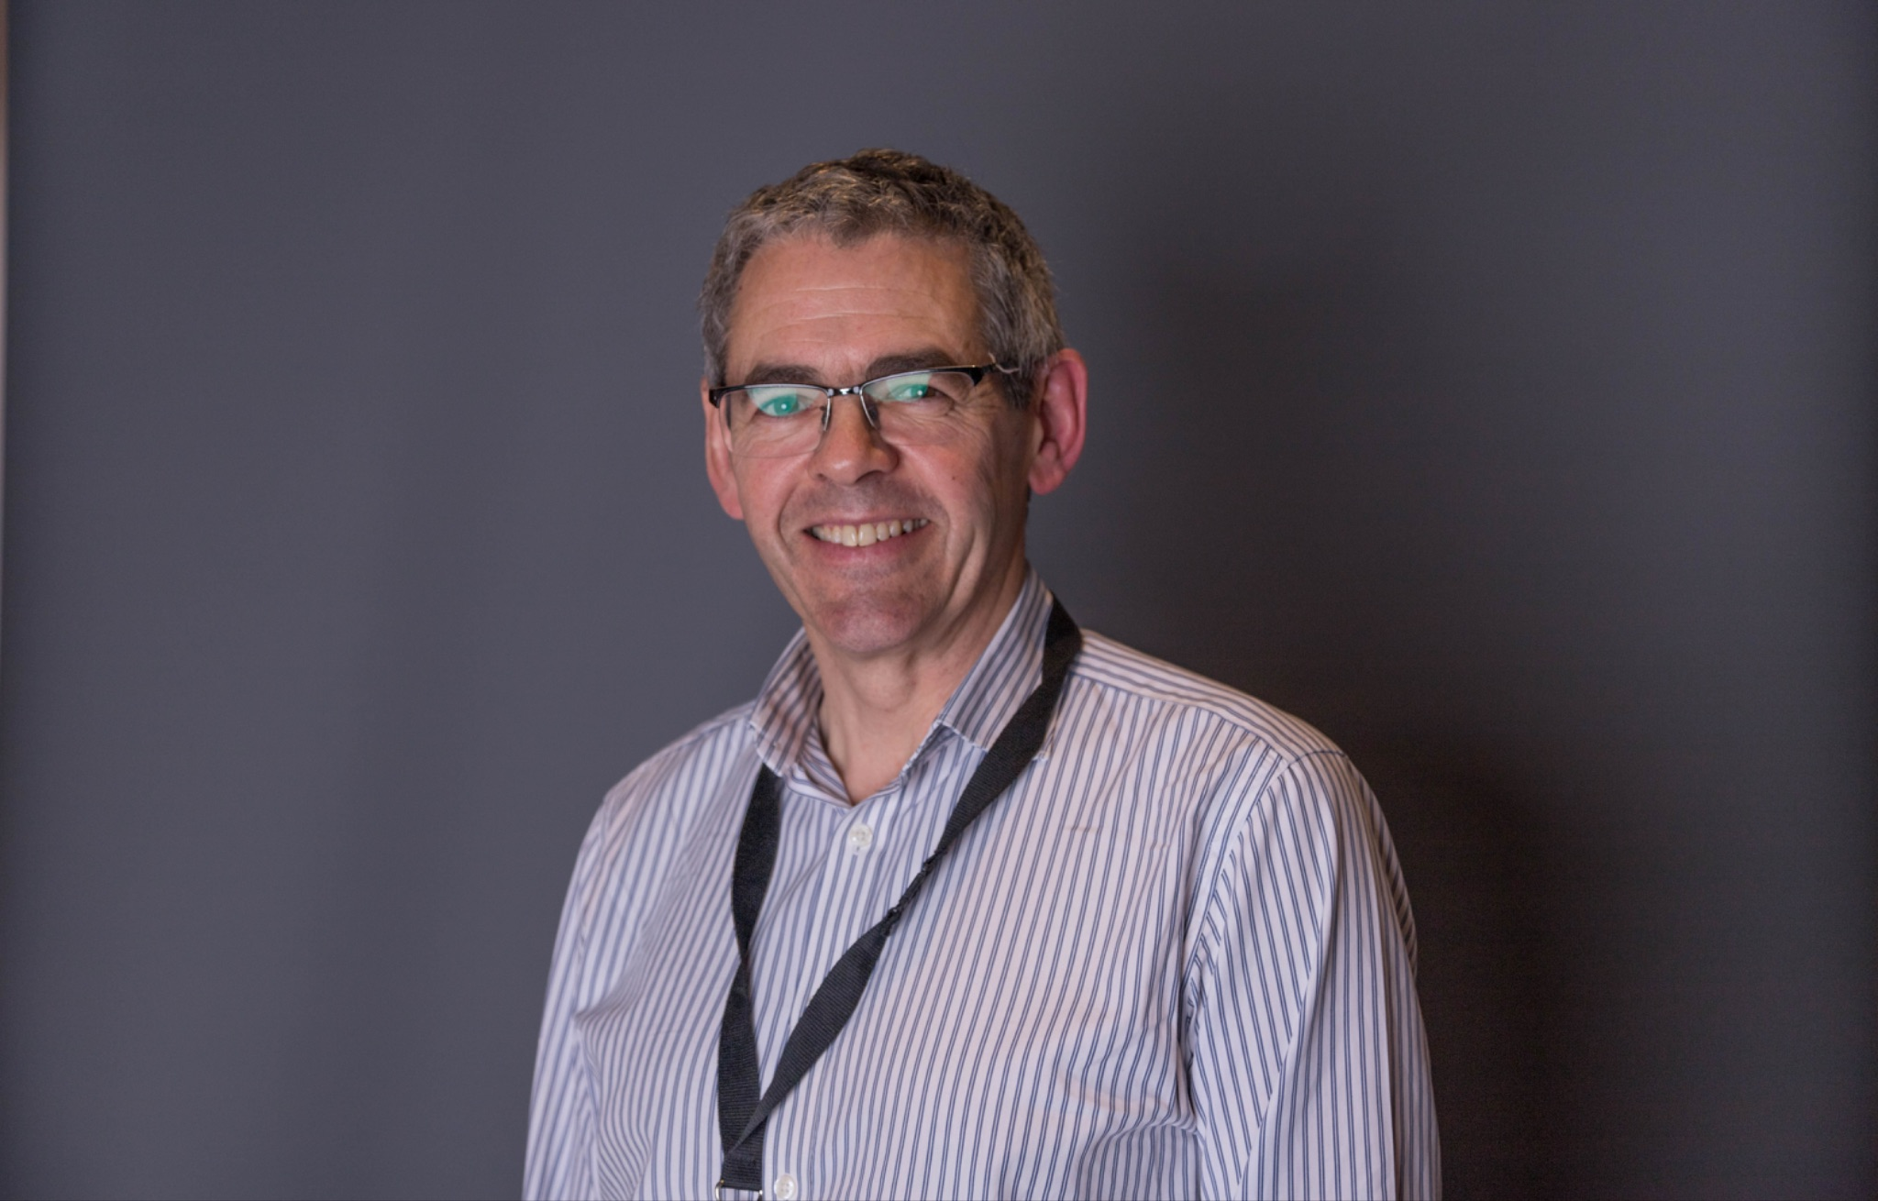

Genesis
TAKE 2
Pilot Health Service Modelling Associates (HSMA) Programme (2016 - 2017)
Early idea by Prof Martin Pitt (PenCHORD Director) and the late Prof Ken Stein (Professor of Public Health)
In 2015, began design to make reality, and took around to local chief execs / COOs :
6 associates recruited from around SW
12 month, day a week
Teach them skills in DES (pathway modelling) - using Simul8 (secured licenses for 12 months)
Mentoring support to apply new skills to work on real world projects from their organisation
Learning Set Meetings
Workplace Supervisor
Final event where they present work
All provided free of charge
Evaluation of pilot

Slide 6
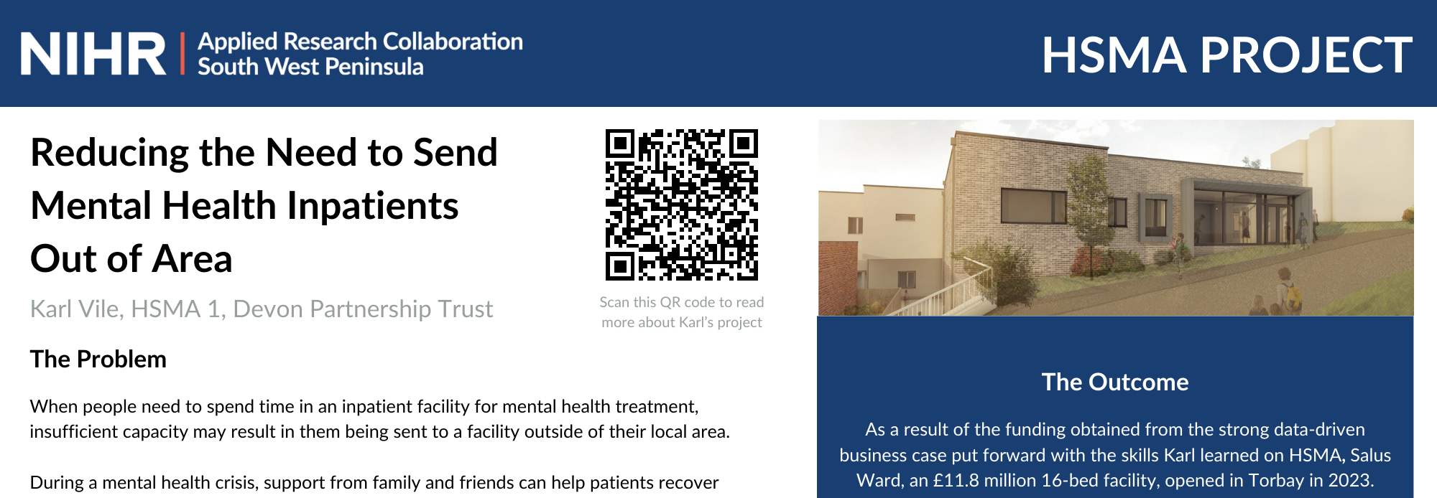
Genesis
Generated significant impact!
Group valued opportunity to collaborate with others from sector (often for first time!)
Generated huge interest and engagement
Most of the associates were promoted swiftly to senior roles
Increased awareness of OR in local NHS
Discovered huge latent skills base in NHS analysts
100% of associates wanted to continue modelling, but 0% of trusts could afford the ~3k software license
Despite engagement, HSMAs struggled to get organisation to fully protect time
We were turning away interest from outside the region
Lots of issues getting hold of data and data quality issues
Models couldn’t be shared more widely due to proprietary licensing

Slide 7

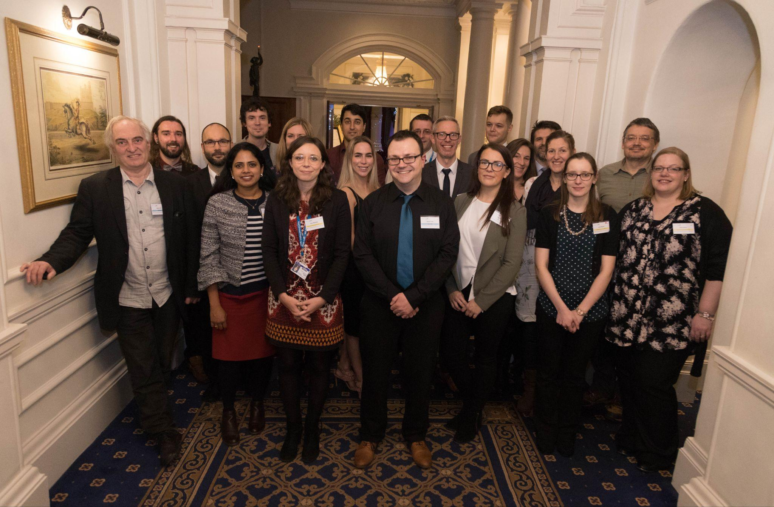
Changes
TAKE 3
HSMA 2018 (2018)
Transitioned to FOSS (SimPy and JaamSim to replace Simul8, core Python skills, very early Machine Learning training)
Expansion from just DES to also geographic modelling, Machine Learning, System Dynamics and more
New two phase Structure :
Phase 1 (3 months) : Training
Phase 2 (9 months) : Project Work
Learning Set Meetings in Phase 2 (down the pub)
More than quadrupled intake (26 vs 6, from 52 applications), though still SW-based
New project selection process

Slide 8
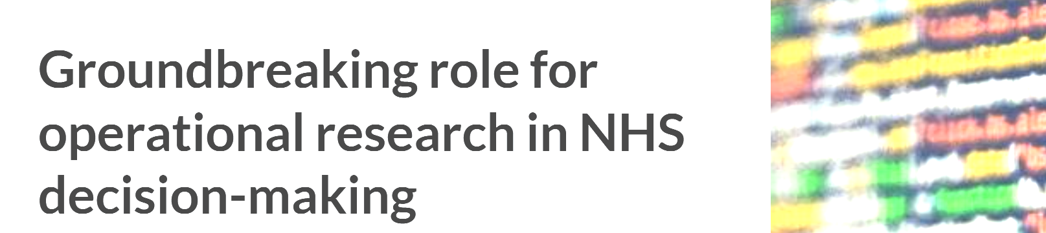
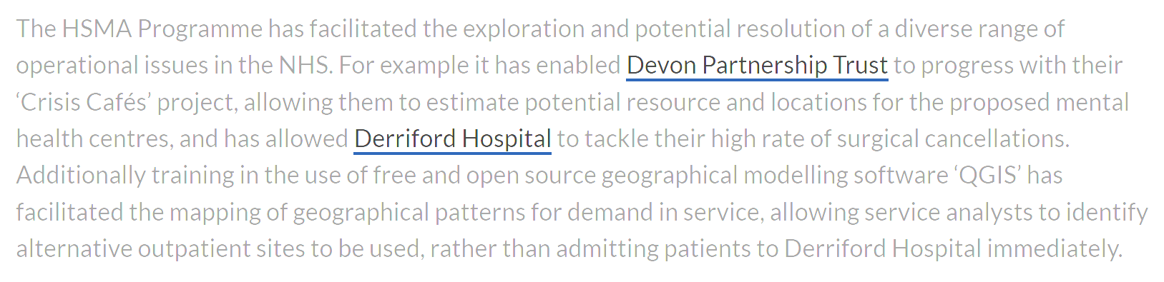
Changes
Even more impact!
Established new data science roles and teams
Most projects were cross-organisation collaborations
More associates promoted, some went on to undertake MSc
Further increased awareness of OR in local NHS
Discovered non-coders can pick up skills well
Lots of associates went on to continue using and building skills
Models could be shared freely
Despite engagement, HSMAs struggled to get organisation to fully protect time
We were turning away interest from outside the region
Meeting in the pub sounded great, but didn’t work with such large cohorts
Lots of issues getting hold of data and data quality issues

Slide 9



Together in Electric Dreams
TAKE 4
HSMA 3 (the online pilot) (2020-21)
Transitioned to online delivery model (though still SW England)
Inclusion of policing associates
Intake of 40
Introduction of Peer Support Groups
New HSMA Slack Community Hub
Vastly expanded training (up to 17 days from 6), adding Agent Based Simulation, NLP, forecasting and more

Slide 10
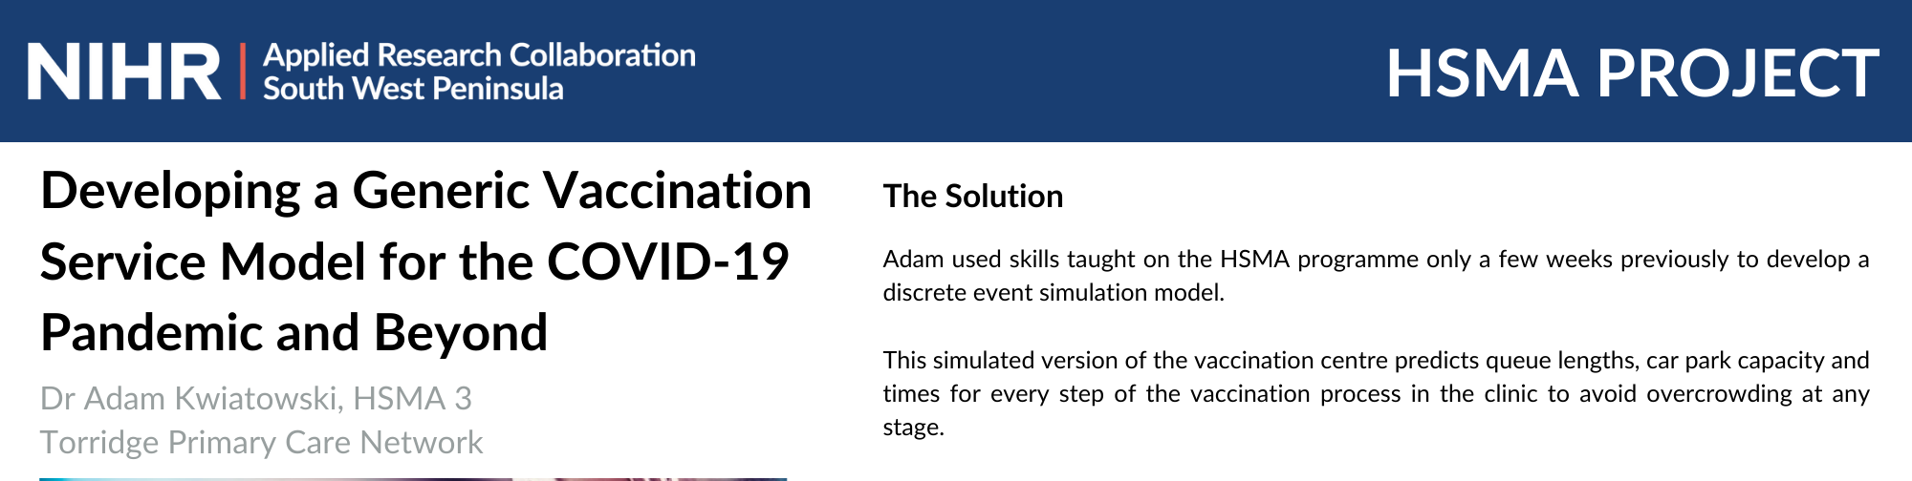
Together in Electric Dreams
IMPACT!
The LIVE online model works!
Policing associates didn’t work with health system problems the way we hoped
Larger class sizes becoming feasible
Non-live online engagement is much poorer
People who have never coded before found their new passion
Peer Support Groups help collaboration and development of skills
The training’s getting a bit intense for 3 months…
We were turning away interest from outside the region
Established more new data science roles and teams
Policing associates have similar challenges and need access to these skills
Despite engagement, HSMAs struggled to get organisation to fully protect time
Most projects were cross-organisation collaborations
Lots of issues getting hold of data and data quality issues
Significant resistance to FOSS software installations

Slide 11


Everybody Wants to Rule the World
TAKE 5
“Planet HSMA” era (4, 5, 6, 7+ : 2021 - PRESENT)
Switched to 15 months (6m Phase 1 + 9m Phase 2)
Opened nationally across England - cohort sizes 80 (4), then 113 (5), then 178 (6) (HSMA 6 nearly 30 times the size of HSMA 1)
Further expanded training
First course ever accredited by AphA
The brilliant Sammi Rosser joined me in 2023
“Any project, any time”
Project Development Clinics
Trainee Mentor Scheme and wider community of mentors
New HSMA website (https://hsma.co.uk/)
eBooks
YouTube (https://www.youtube.com/@hsma)

Slide 12
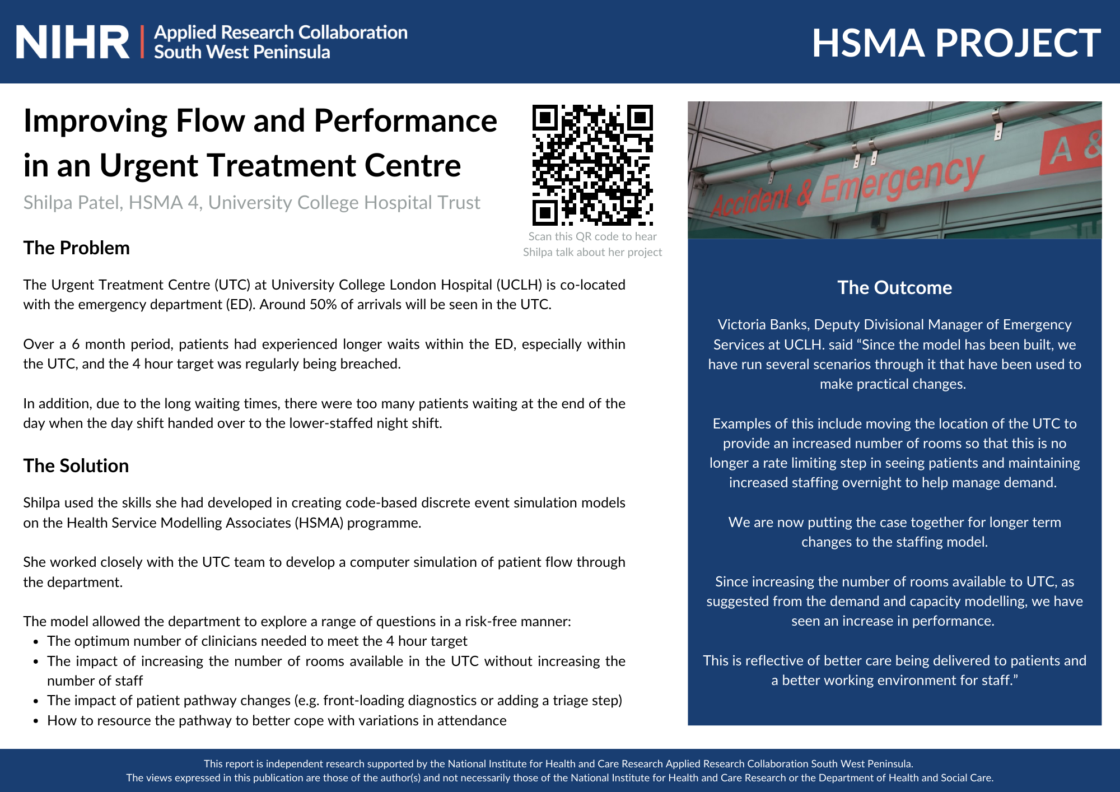
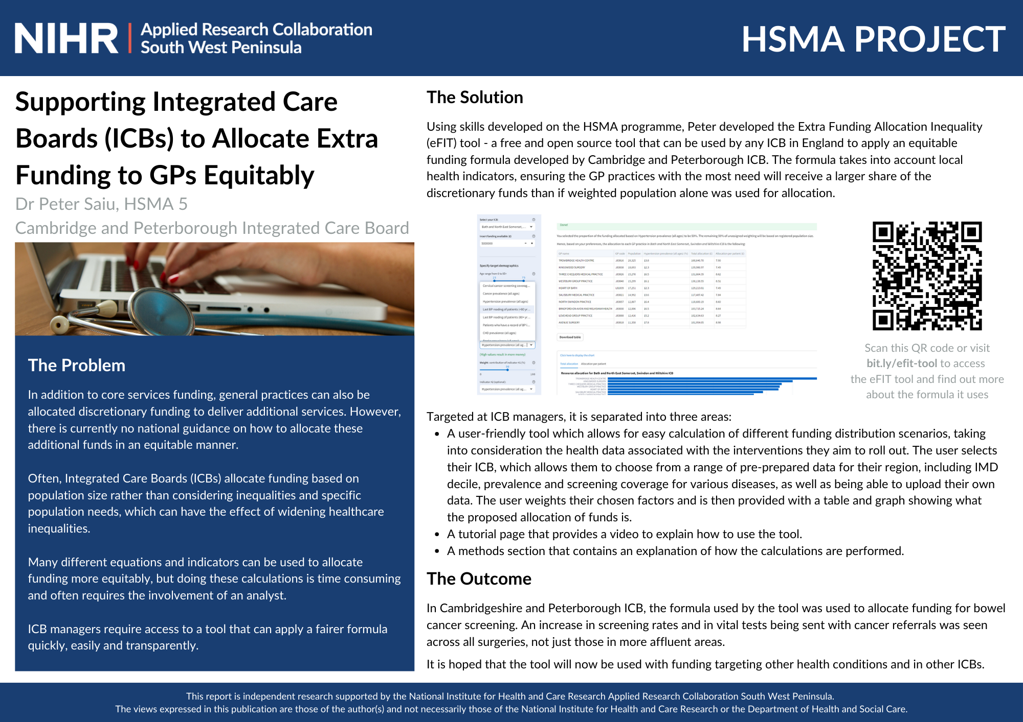
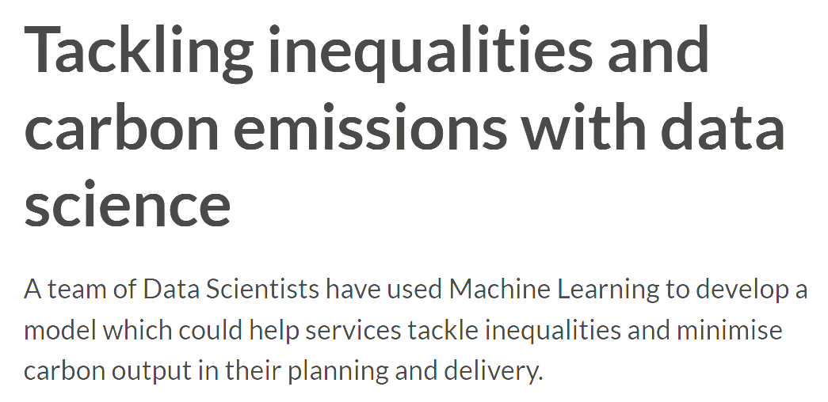
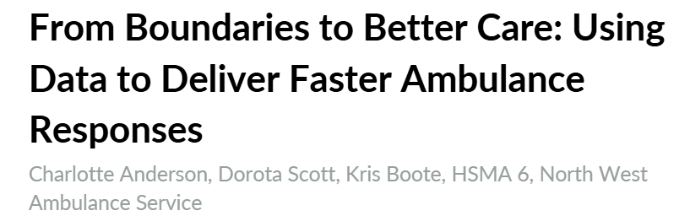
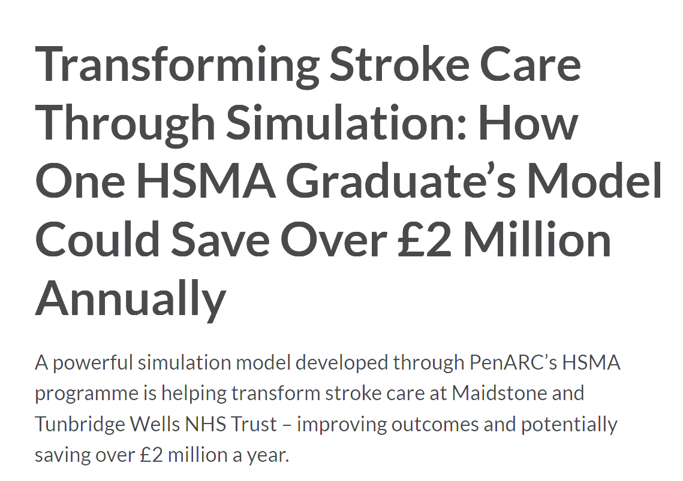
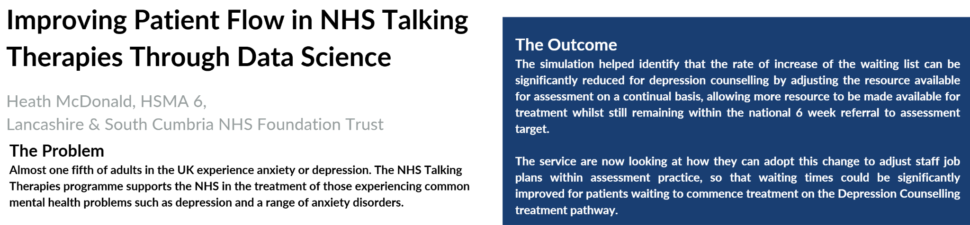
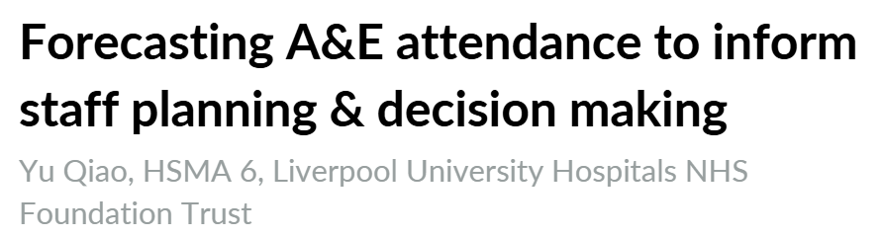
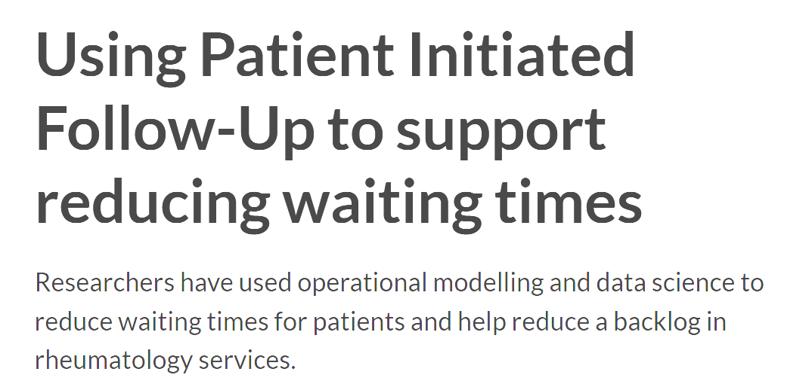
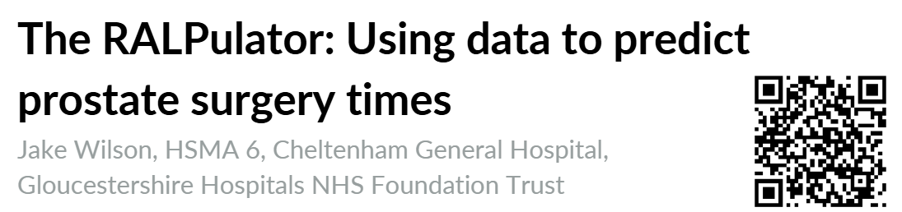
Everybody Wants to Rule the World
Impact onslaught!

Slide 13
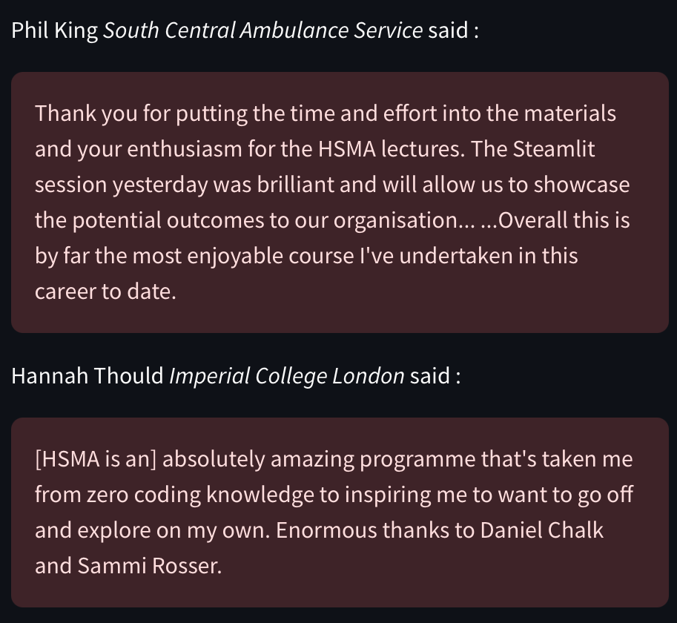
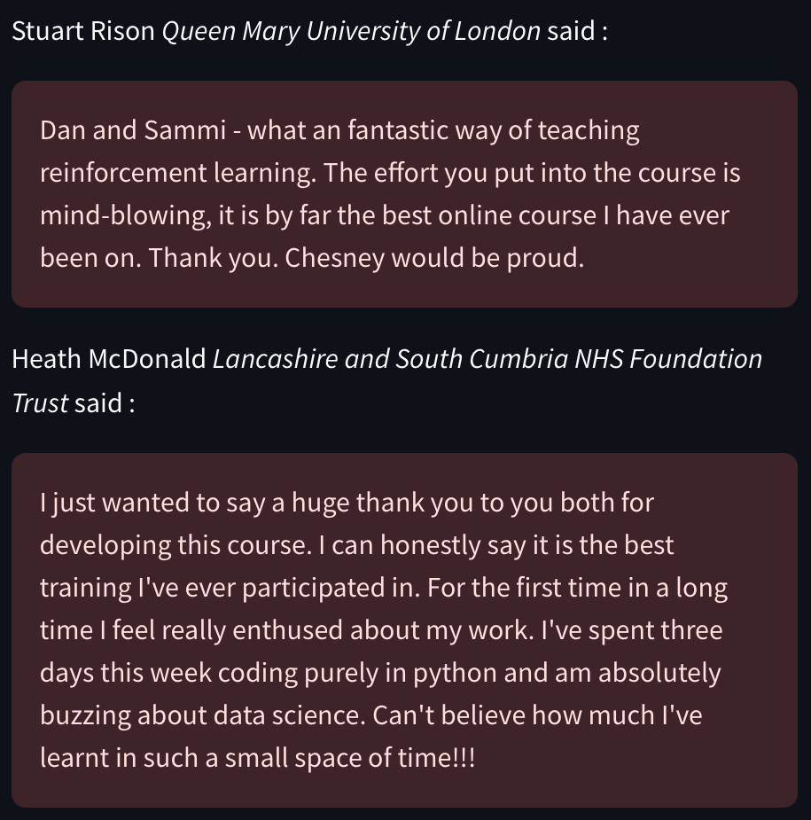
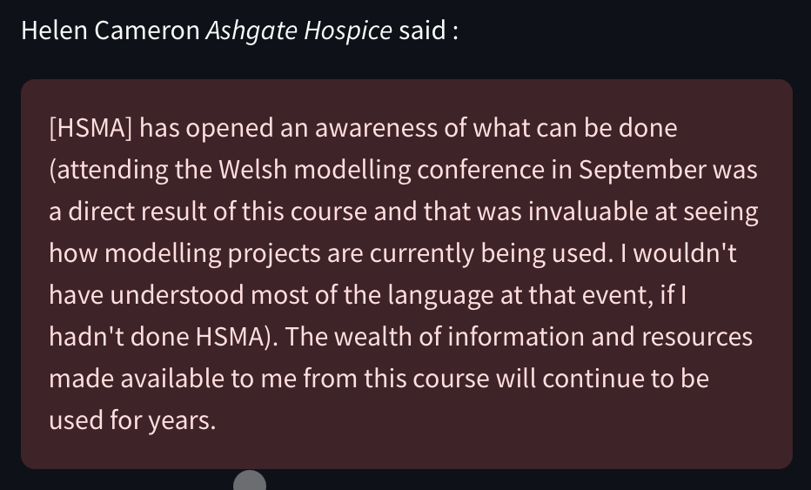
Everybody Wants to Rule the World
Transformative effect for skills development!

Slide 14
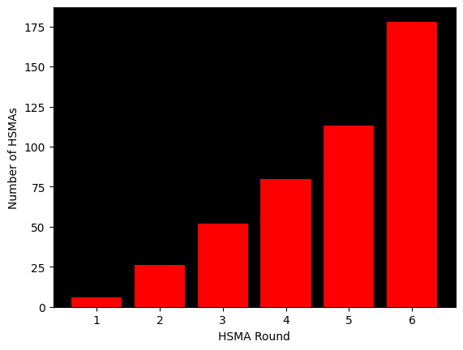
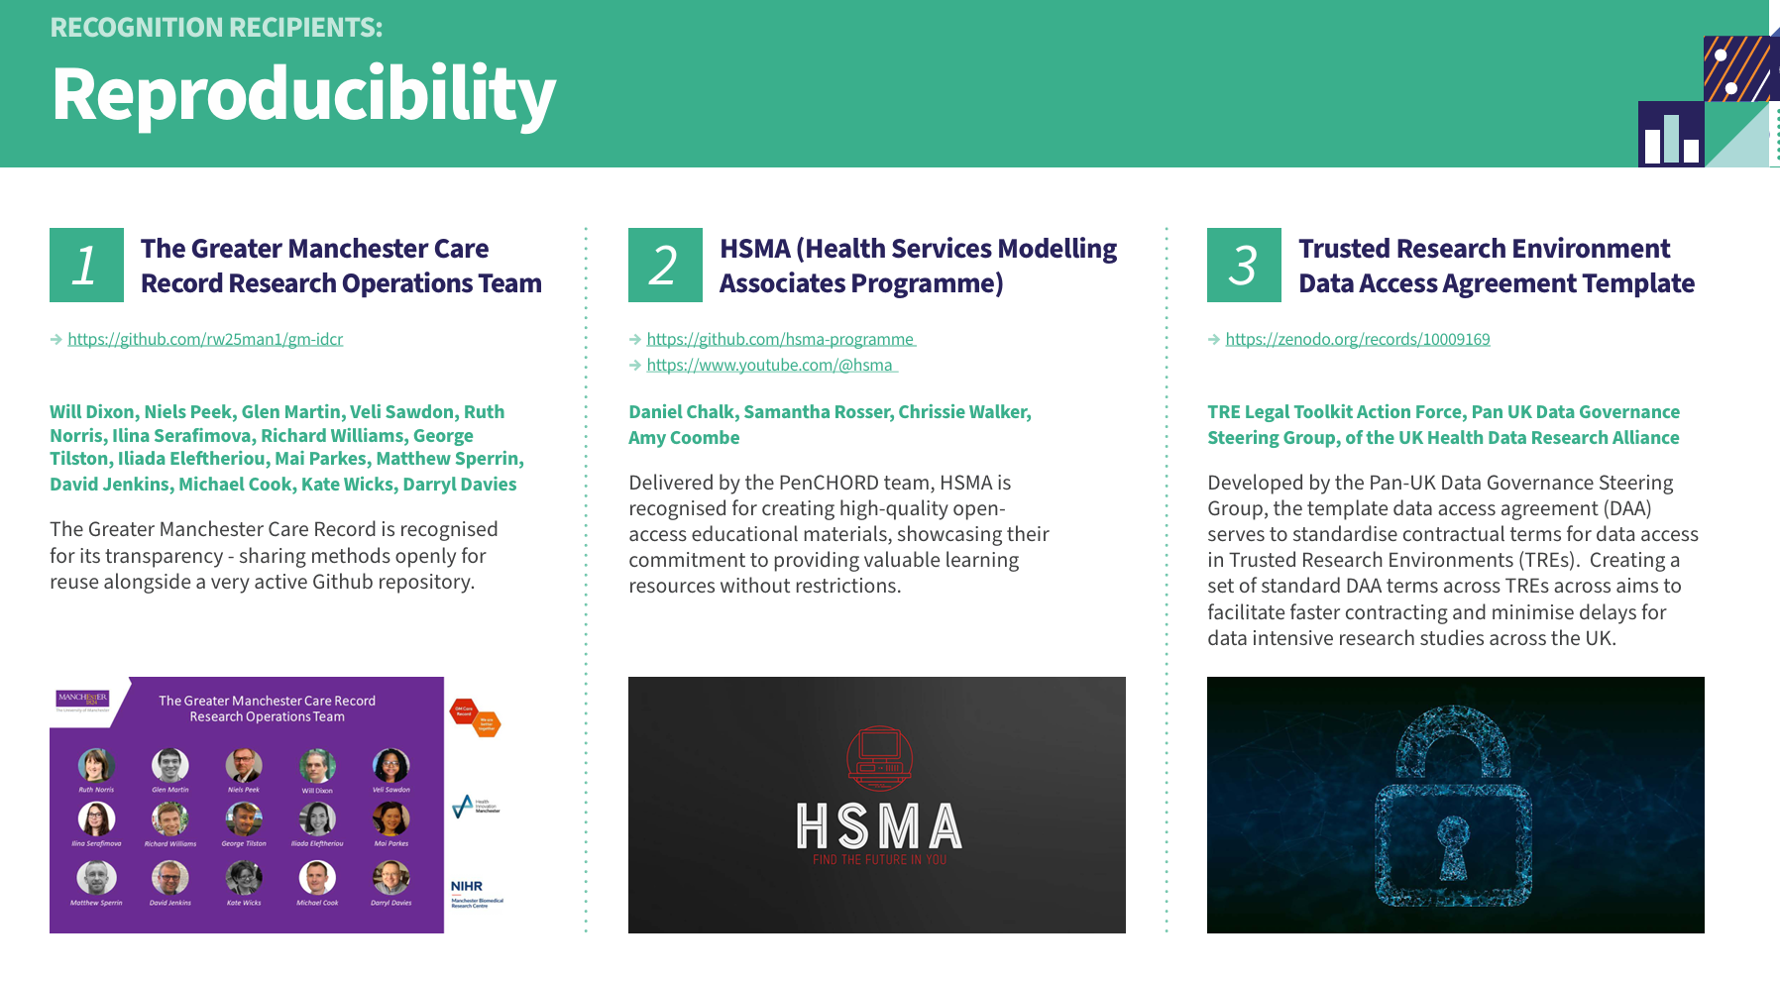

Everybody Wants to Rule the World
Endless demand!
Awards and recognition

Slide 15

Everybody Wants to Rule the World
Still challenges, including some of our old friends
Despite engagement, HSMAs struggled to get organisation to fully protect time
Workplace Supervisor role no longer works
Lots of issues getting hold of data and data quality issues
Need to get true engagement and “buy in” nationally and at a senior level…
We’re now turning away interest outside England
Significant resistance to FOSS software installations
Coming 2026…

Slide 16

Man in the Mirror
So what are the key things I’ve learned over the last 12 years of training and supporting the NHS in modelling and data science?

Slide 17
Brilliant Mind
People working in the health service are brilliant and have often untapped skills
Analysts typically have an aptitude and skill set that extends far beyond what their usual role involves
Clinicians and managers can often have an unexplored passion for modelling, data science and coding
So we should recognise and embrace that…
The power to transform organisations lies within with existing resource
Staff should be given the time and support to unlock their potential (lest we risk a brain drain)
Don’t just teach staff to be better at what they know - allow them to discover and embrace new things and better ways (step away from the spreadsheet…)
There is much more potential for common language and understanding between roles within healthcare than it may first appear

Slide 18
Opportunities (Let’s Make Lots of Money Impact)
The health service is full of problems that can hugely benefit from modelling and data science approaches
Modelling and data science can (and has!) improve services, make things better for patients and their organisations
Most people working in the NHS have never heard of Discrete Event Simulation, even though it can help tackle problems around delays (a big % of problems)
Once people are made aware, they often see the huge potential of these approaches
So we should…
Raise awareness of these approaches until they become widely known (and then, hopefully, adopted)
Clearly communicate the benefits of these approaches, showcase what has been done before, and demonstrate local-level improvement
Give analysts (and others who have come into contact with these approaches) a stronger voice to champion this way of working
Get rid of any lingering pens on a piece of a string

Slide 19
I Want to Break Free
Free and Open Source (FOSS) solutions are the future of analytics, and the NHS can’t be data science ready without embracing this
FOSS allows for transparency, which is vital when the evidence generated affects lives and quality of life
FOSS encourages collaboration and sharing, which enables organisations tackling the same / similar problems to work together and all benefit
FOSS ultimately removes barriers to uptake and helps promote sustainable and self-sufficient futures
So we should…
Recognise and understand the frictions and barriers to adoption of FOSS as standard within the NHS
Identify how those barriers can be removed
Improve awareness and demonstrate a “better way”

Slide 20
Together Forever
People in the health service typically want to work with others, and dislike working in silos
Bringing people together allows for recognition of common problems, sharing of ideas to tackle them, and pooling of skills and aptitudes to benefit everyone
Collaboration has been a cornerstone of HSMA learning and project work since its inception, and great things happen when it’s embraced
“Live” training in HSMA has generated far more engagement than asynchronous learning approaches
So we should…
Encourage collaboration as the status quo, not an outlier
Find ways to bring organisations together to tackle common challenges
Support staff to embrace opportunities to collaborate, and give them a platform to share their learning and experience back with you
Promote the benefits of live learning to encourage collaboration, engagement and peer support

Slide 21
Take Me to Your Heart
If we want to bring about real uptake and change, we need to bring leaders and decision makers on board
Analysts are often disconnected from the decision making process within organisations, despite the evidence they generate and their insight
Those with the technical skills (either developed or latent) are not typically those determining strategic direction and priority
True potential for modelling and data science can be limited if the right problems aren’t being addressed / right questions aren’t being asked
Staff with the modelling and data science skills can struggle to dedicate the time needed if it isn’t seen as a priority
So we should…
Find ways to engage with senior leaders and decision makers to make them aware of these approaches and what they can do
Get them excited about possibilities, whilst managing expectations (can give you quick answer now that’s probably wrong vs answer next week but you probably will never need to ask me again)
Support them to learn how to ask the right questions, and how to interpret the answers

Slide 22



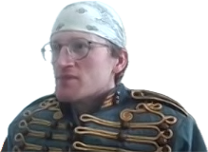

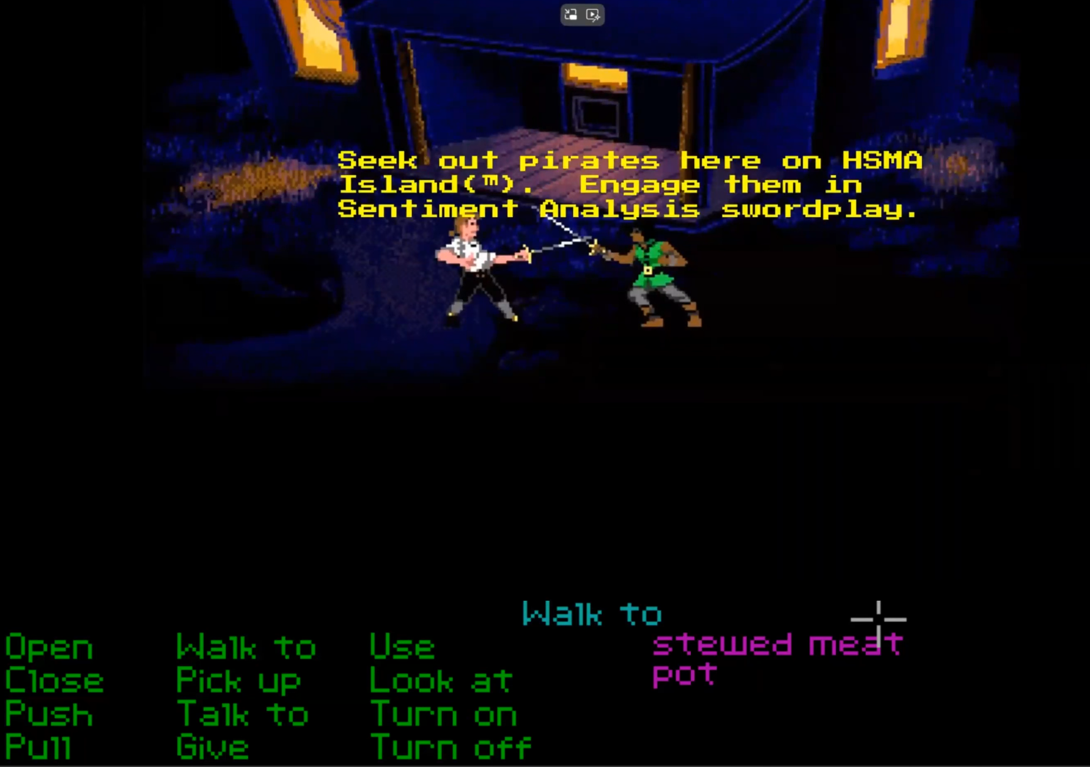



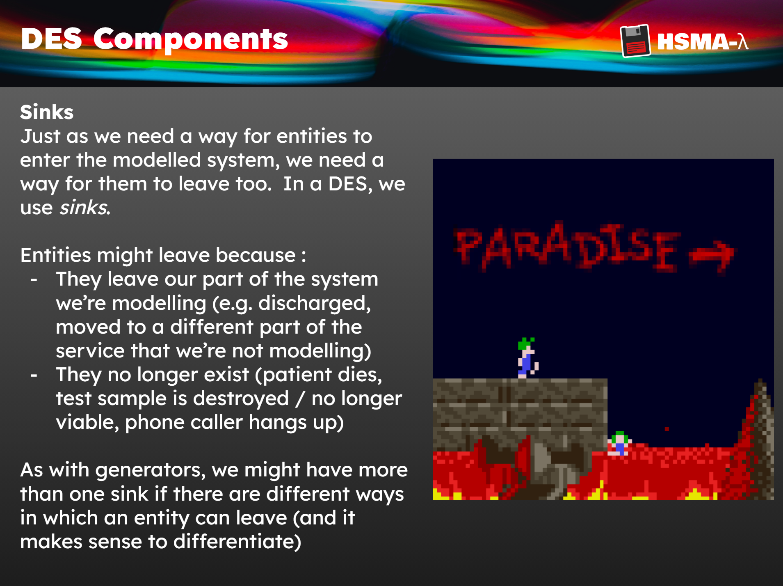

Analysts Just Want to Have Fun
Just because subjects are heavy and / or dry, it doesn’t mean they can’t be engaging
We’ve worked hard to give HSMA a sense of “character”, and always look for ways to make learning enjoyable and engaging
When people are enjoying themselves, they’ll remember things more
Helping people find new interests and passions leads directly to real impact

Slide 23
Analysts Just Want to Have Fun
So we should…
Not be afraid to bring our own character and passions to training - people respond to this; even if they don’t share your passions, it creates positive emotional responses and sets a tone of “Follow your interests”
Find ways to nurture the new passions and interests that people discover - these are things that drive and motivate them to apply new skills and generate impact
Give people an opportunity to practice their skills in entertaining ways

Slide 24
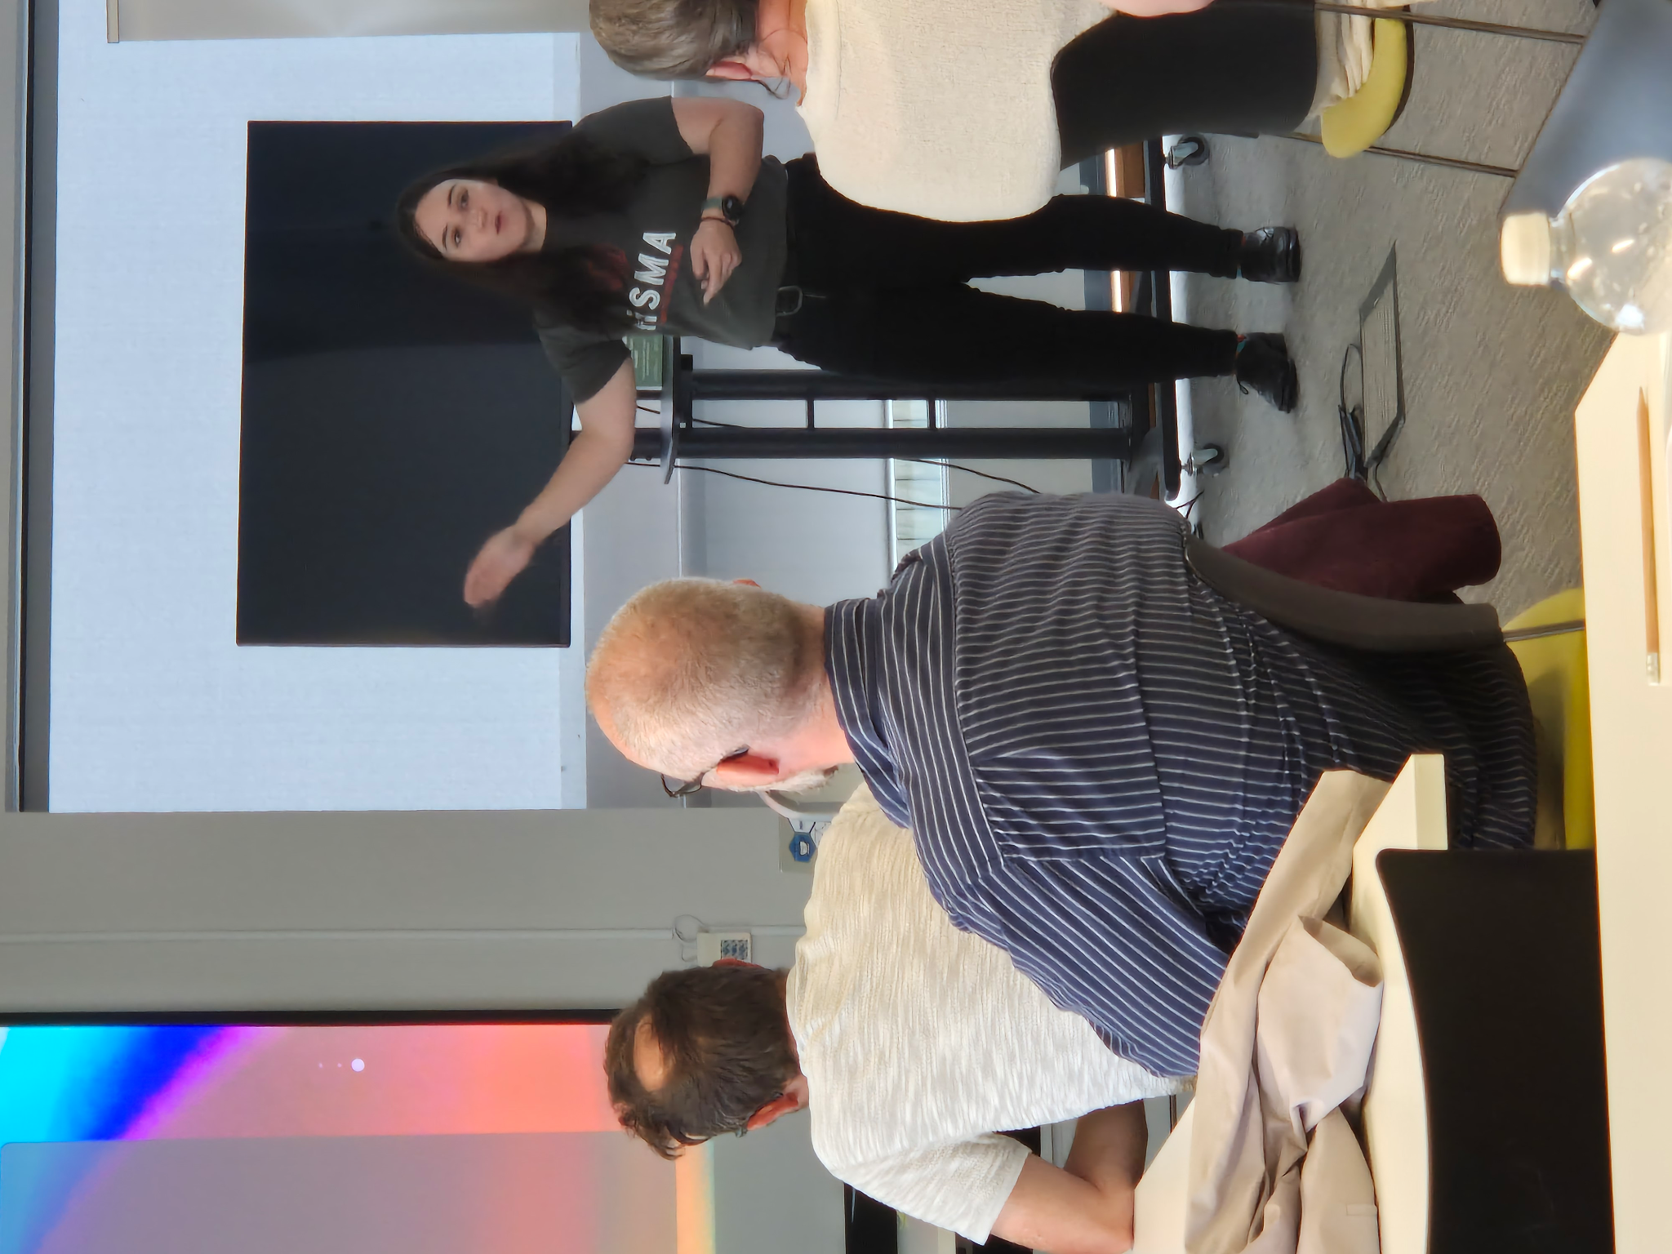
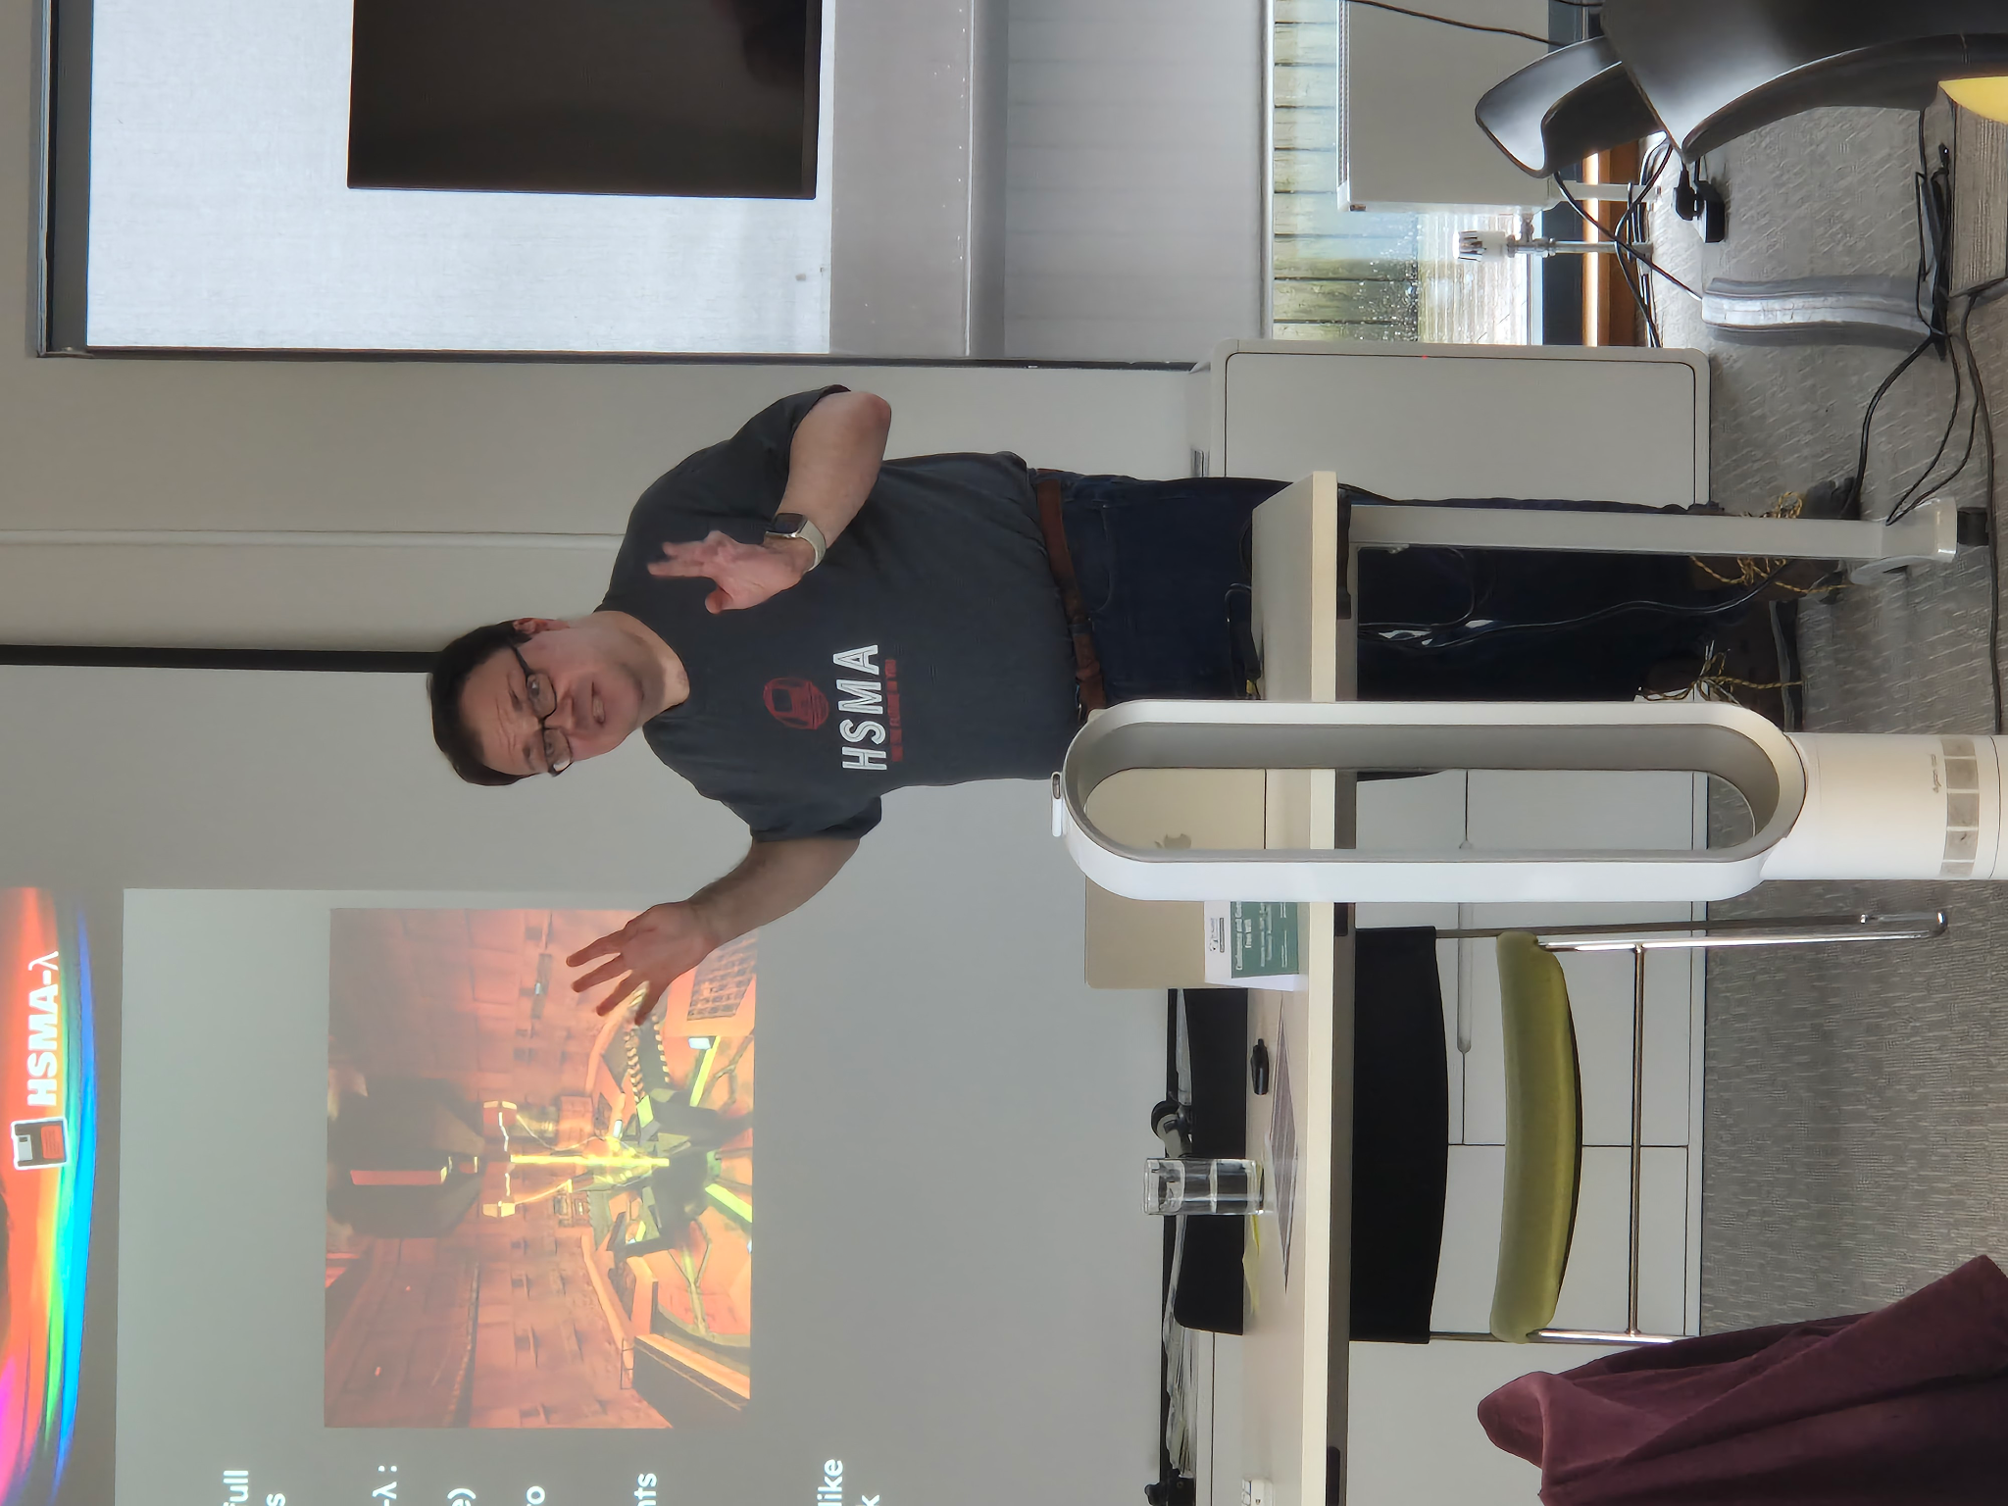
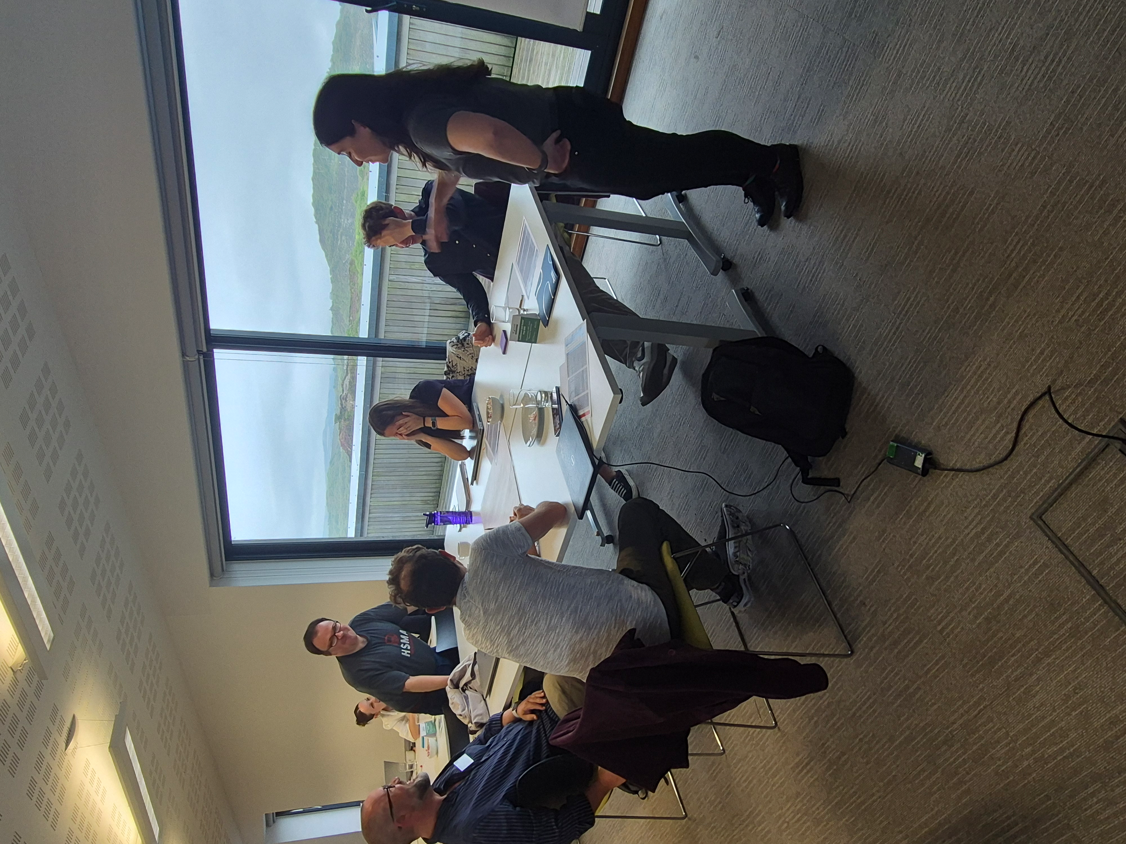
Back to the Future
7
penchord@exeter.ac.uk
https://hsma.co.uk/

Slide 25


The Final Countdown
A final message from our HSMA mascot Chesney Chalks :
“No one can be myself like I can
For this job I'm the best man
And while this may be true
You are the one and only you.
Find the Future in You”
https://hsma.co.uk/

